Slide 1



Beyond
Analysis
Brought to you by AMAN SAINI

Slide 2
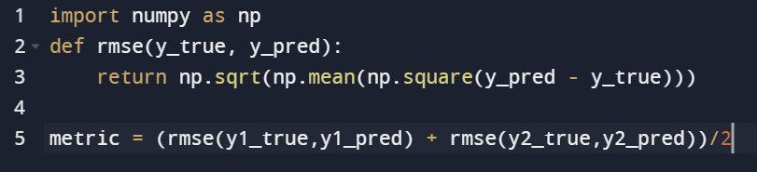
Competition Overview
Predict the customer value (Y1) and extrapolate temporal variation (Y2). We are provided with 22 features spanning various aspects of customer interaction. Temporal variation is captured by a numbered sequence of entries for each customer.
A customer can have multiple corresponding sequences, but only one set of (Y1, Y2) for each customer.
Metric:
Root Mean Squared Error (RMSE)
The evaluation metric is the mean of RMSE of Y1 & RMSE of Y2.

Slide 3
Dataset
22 Features
 | Rows | Unique Customers
Train | 1246837 | 96298
Test | 979059 | 65242
m₁ x 22
Customer - 1
Y1, Y2 for customer - 1
Customer - 2
m₂ x 22
Y1, Y2 for customer - 2
Customer - n
Y1, Y2 for customer - n
m_{n} x 22
Visual representation of customer data with few basic stats
m_{i} = Number of sequence entries for customer i

Slide 4
Prediction Pipeline
22 Features
Feature Engine
Aggregated Features
Customer - i
5-Fold CV
The local evaluation pipeline components are denoted in red color.
K Fold cross-validation helps in building a robust local validation environment.
Prediction
Model
Y1 | Y2

Slide 5

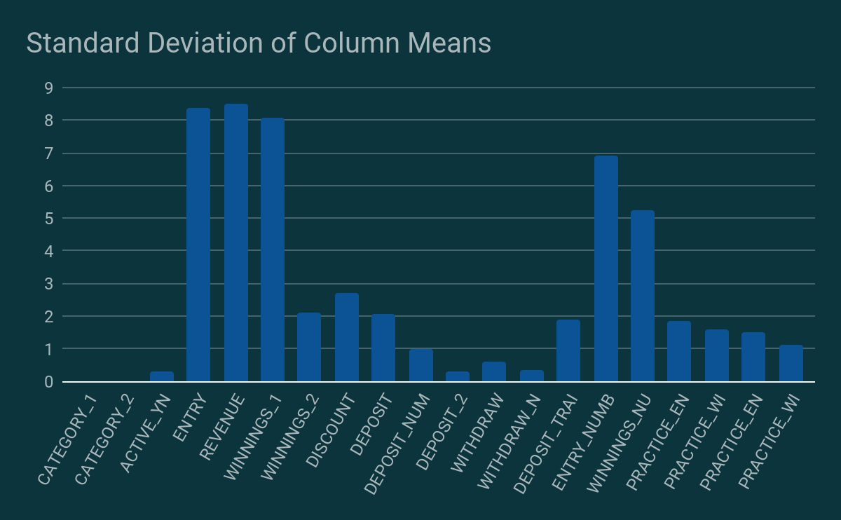
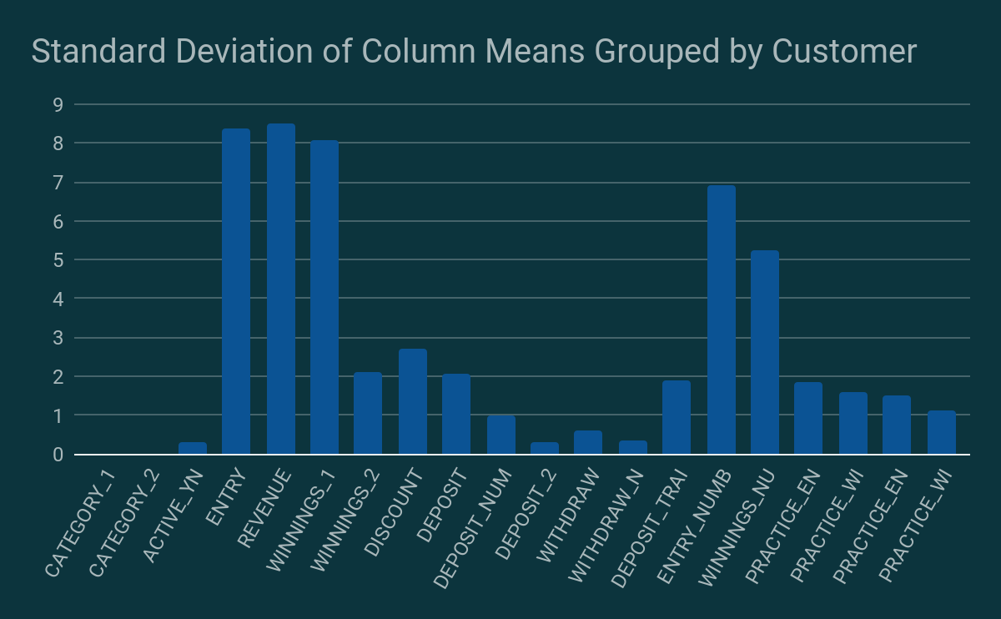
What’s Inside The Feature Engine?
Aggregation Functions
Mean
Sum
Standard Dev.
Maximum
Minimum
Number of unique values
Deviation from the global mean
Feature Engine
These are some essential aggregate functions we have applied to the dataset for each customer ID.
Note that not every function can be applied to all the features. We need to look at each feature and see if it is varying enough (chart on the left) to be converted into a single value.

Slide 6
Modelling
LightGBM
Fast and Accurate for structural data
Comes with parallel processing
Good way to study interaction b/w predictors and target
66.284
RMSE
CatBoost
Minimal hyperparameter tuning
Fast and Accurate for structural data
Provides different algorithm under one framework
66.261
RMSE
DNN
Comes with parallel processing
Inbuilt hyperparameter optimization
Good for diversity when used with boosting
66.831
RMSE
Ensemble
Three different algorithms gave high diversity for this ensemble model
Ensemble consisted of all three models performed best on the LB out of all the possible combinations of models.
66.194
RMSE
All scores were recorded on Public Leaderboard

Slide 7
Experimentation Cycle
04
Baseline
Local CV
Made a baseline model of simple DNN and tried to improve the score from there.
We used a 5-Fold cross-validation strategy for local evaluation.
01
03
Feature extraction/selection
Hyperparameter Tuning
Continuously checked for better performing features and kept experimenting with different subsets features.
We used Bayesian optimization for boosting model and hyperband optimization for DNN.
02

Slide 8
Result
Ensemble of all three models performed best from all the possible combinations of models.
Ensemble of boosting models also performed reasonably enough when compared with single models.
Categorical features helped to optimize both CV and LB results.
Bayesian and Hyperband optimization saved a lot of time in hyperparameter tuning.
Secured 10th rank on public leaderboard and 14th rank on private leaderboard.

